Slide 1
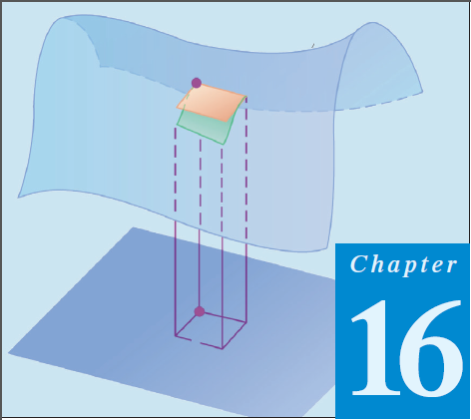
10
Thomas Calculus 12th (Chapter 16)
Calculus 9rd, Dale Varberg, Edwin Purcell and Steve Rigdon (C.14)
Green’s Theorem in the Plane
Samuel Lukas

Slide 2
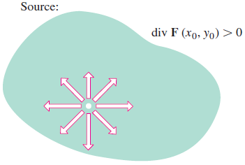
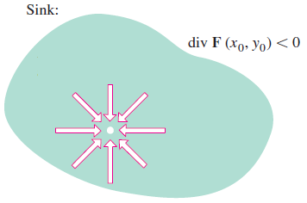
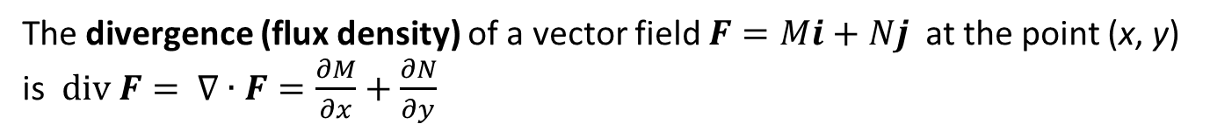
Divergence
The divergence (flux density) of a vector field $F=Mi+Nj$ at the point (x, y) is $div F= ∇∙F=\frac{∂M}{∂x}+\frac{∂N}{∂y}$
Find the divergence of $F=(x^{2}−y)i+(xy−y^{2})j$
Solution We use the formula $div F=\frac{∂M}{∂x}+\frac{∂N}{∂y}=\left(2x\right)+\left(x−2y\right)=3x −2y$

Slide 3
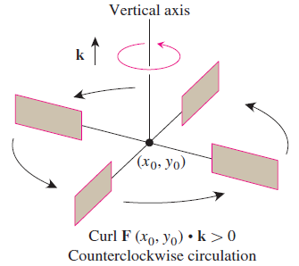
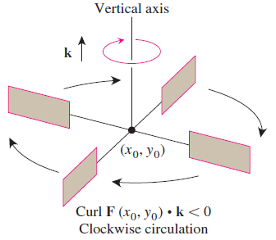
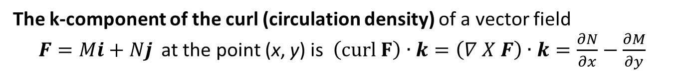
Spin Around an Axis: The k-Component of Curl
The k-component of the curl (circulation density) of a vector field
$F=Mi+Nj$ at the point (x, y) is $\left(curl F\right)∙k=\left(∇ X F\right)∙k=\frac{∂N}{∂x}−\frac{∂M}{∂y}$
Find the k-component of the curl for vector field $F=(x^{2}−y)i+(xy−y^{2})j$
Solution We use the formula in Equation $=\left(∇ X F\right)∙k=\frac{∂N}{∂x}−\frac{∂M}{∂y}=y+1$

Slide 4
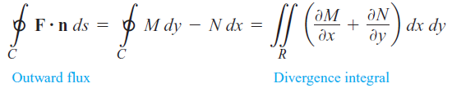
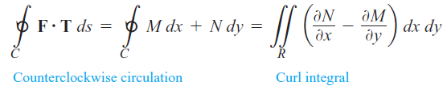
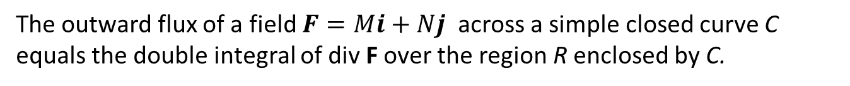
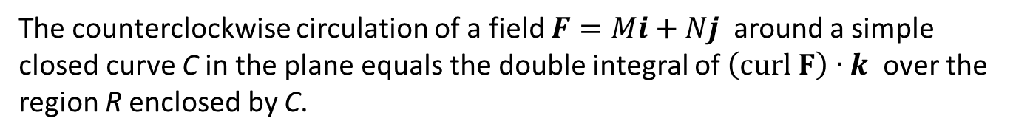
Two Forms for Green’s Theorem
The outward flux of a field $F=Mi+Nj$ across a simple closed curve C equals the double integral of div F over the region R enclosed by C.
The counterclockwise circulation of a field $F=Mi+Nj$ around a simple
closed curve C in the plane equals the double integral of $\left(curl F\right)∙k$ over the region R enclosed by C.

Slide 5


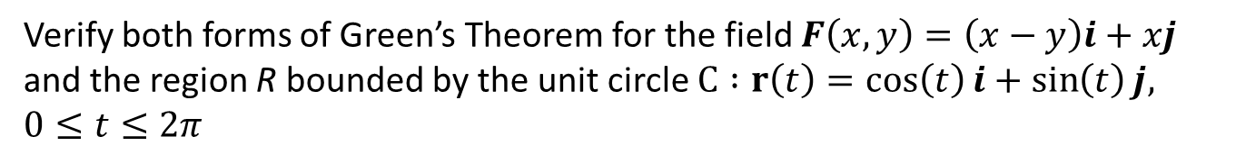
Verify both forms of Green’s Theorem for the field $F\left(x,y\right)=\left(x−y\right)i+xj$ and the region R bounded by the unit circle $C :r\left(t\right)=\cos\left(t\right)i+\sin\left(t\right)j, 0≤t≤2π$

Slide 6




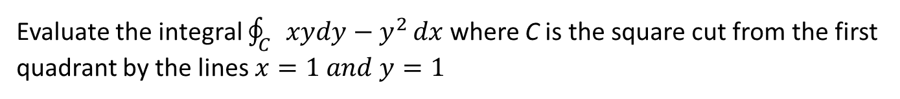
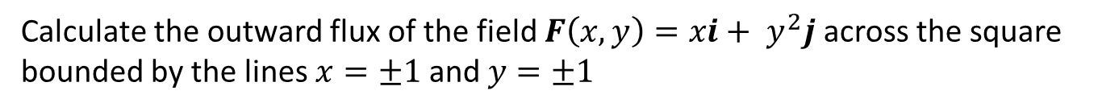
Examples
Evaluate the integral $\oint_{C}{xydy−y^{2}}dx$where C is the square cut from the first quadrant by the lines $x=1 and y=1$
Calculate the outward flux of the field $F\left(x,y\right)=xi+ y^{2}j$ across the square bounded by the lines $x=±1$and $y=±1$

Slide 7




Exercises 1
In Exercises 1 – 4, use Green’s Theorem to find the counterclockwise circulation and outward flux for the field F and curve C.
1.
2.
3.
4.

Slide 8




05.
06.
07.
Find the outward flux of the field $F$ across $r=a\left(1+cosθ\right), a>0$
08.

Slide 9




In Exercises 9 and 10, find the work done by F in moving a particle once counterclockwise around the given curve.
09.
10.
Apply Green’s Theorem to evaluate the integrals in Exercises 11–12.
11.
12.

